Slide 1

Full-stack Development
Week 1 – Intro

Slide 2
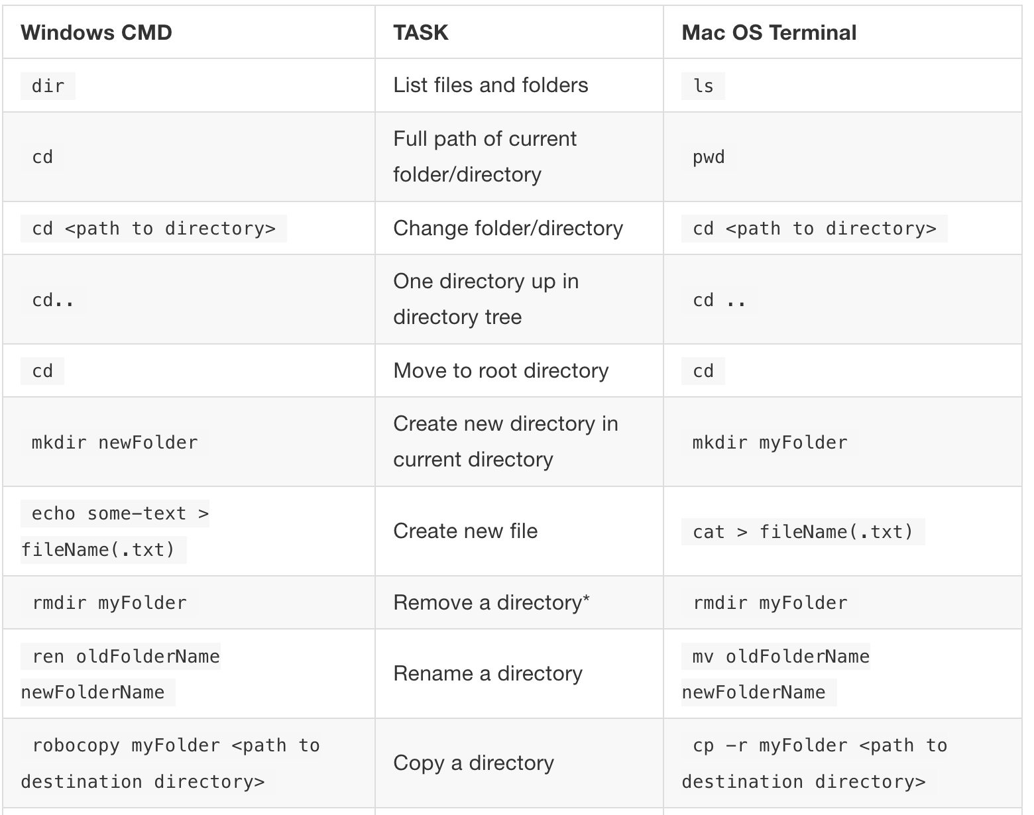
Using the terminal
To use the terminal, we type command line prompts. These are instructions that tell the terminal what we want to do.
These commands vary from Windows to Mac, so here is a link to the basic commands on each OS: https://gfranzini.gitbooks.io/tracer/content/support/command-line-mac-vs.-windows.html

Slide 3
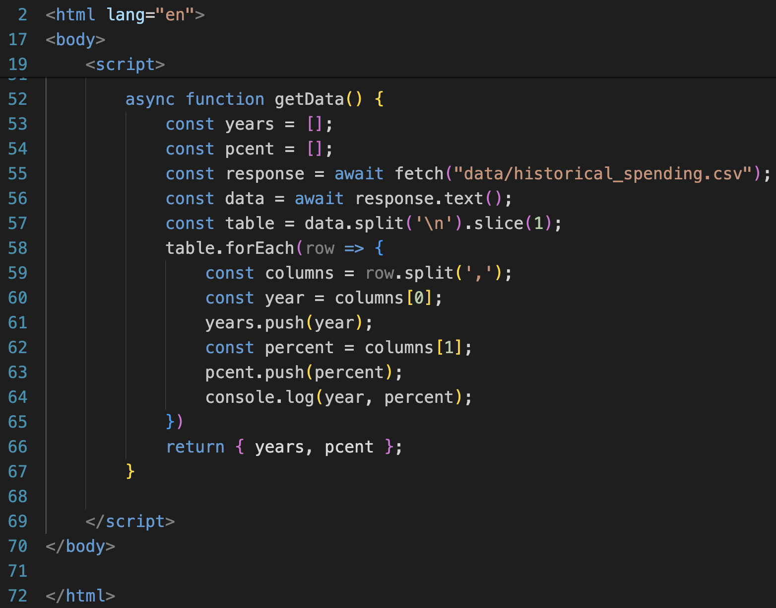
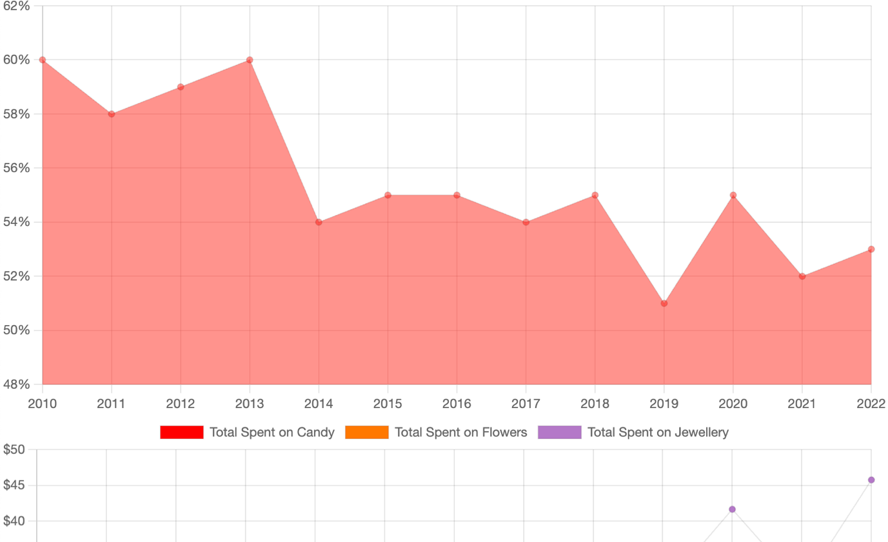
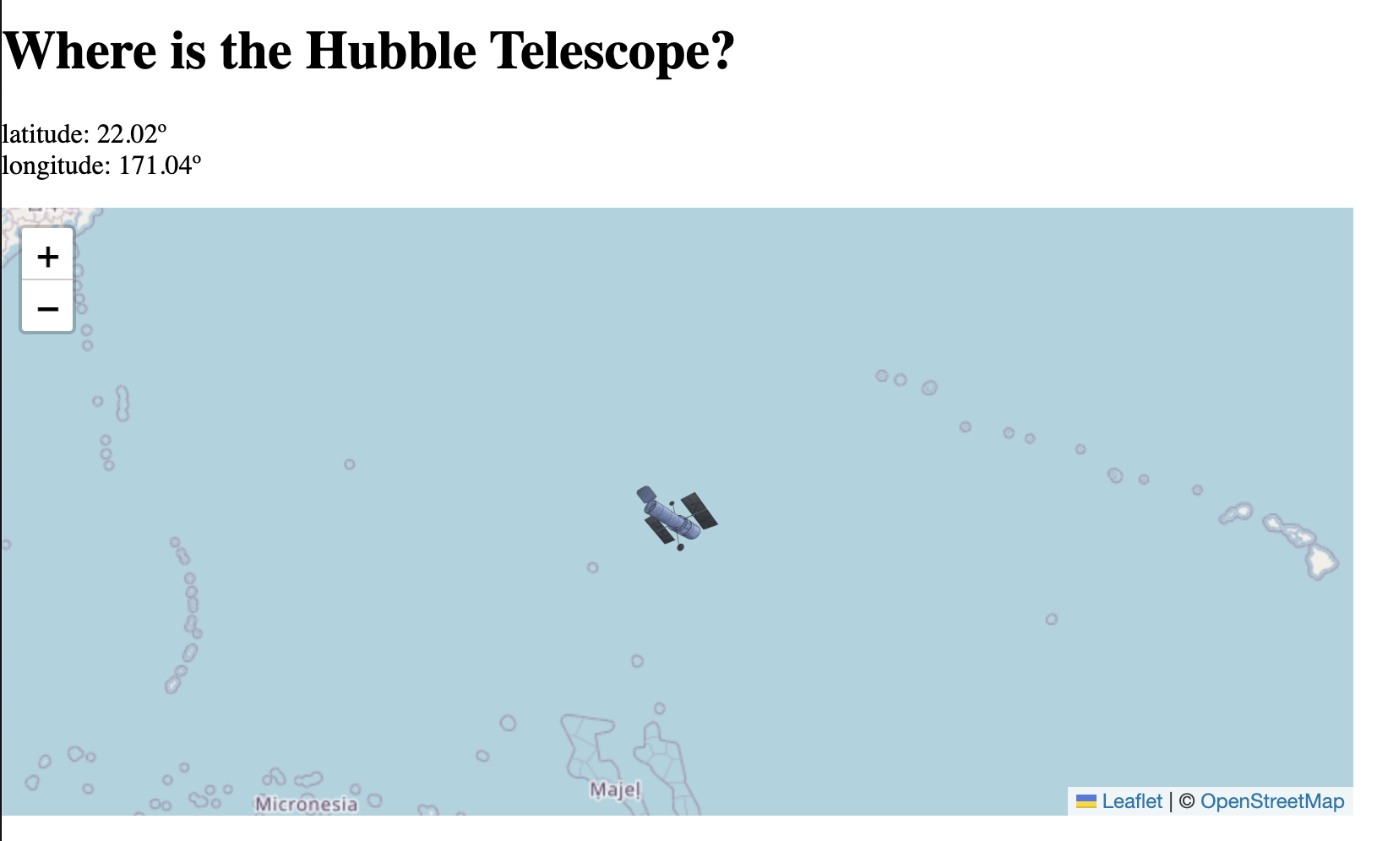
Client-side
So far everything we have coded has been client-side.
All our code has been directly written into the HTML document or included as a JS file.
This code executes all its processes in the user’s browser.

Slide 4
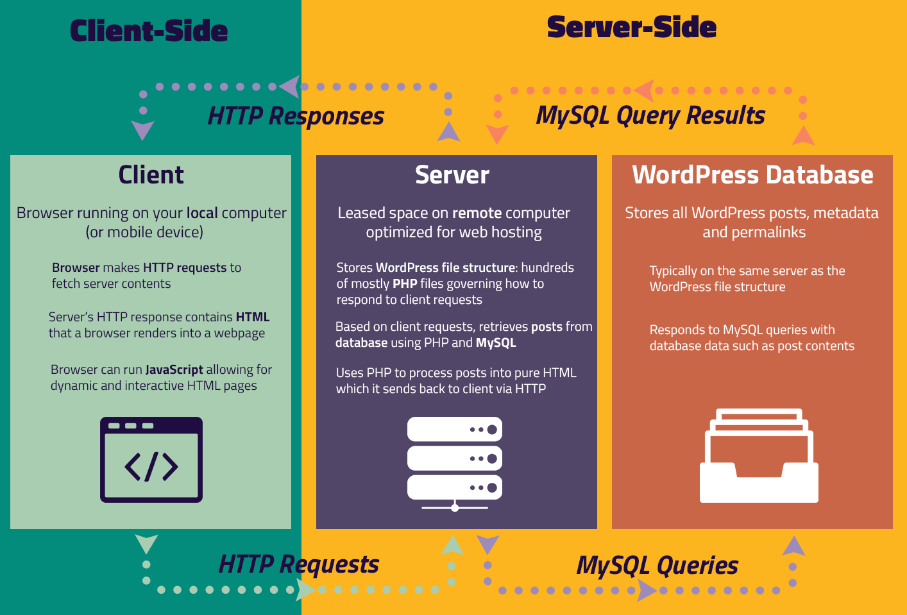
Client-side vs. Server-side
There are, however, many things you will need to do with data that cannot be done client-side.
The purpose of server-side scripting is primarily related to data ‘persistence’. That is the storage and management of data for a particular application.
Data persistence is very difficult and unsustainable to implement on the client’s side.
‘Understanding “Server-Side” and “Client-Side” in WordPress’. WPShout Courses, https://courses.wpshout.com/uar-chapter/understanding-server-side-and-client-side-in-wordpress/. Accessed 26 Feb. 2024.

Slide 5
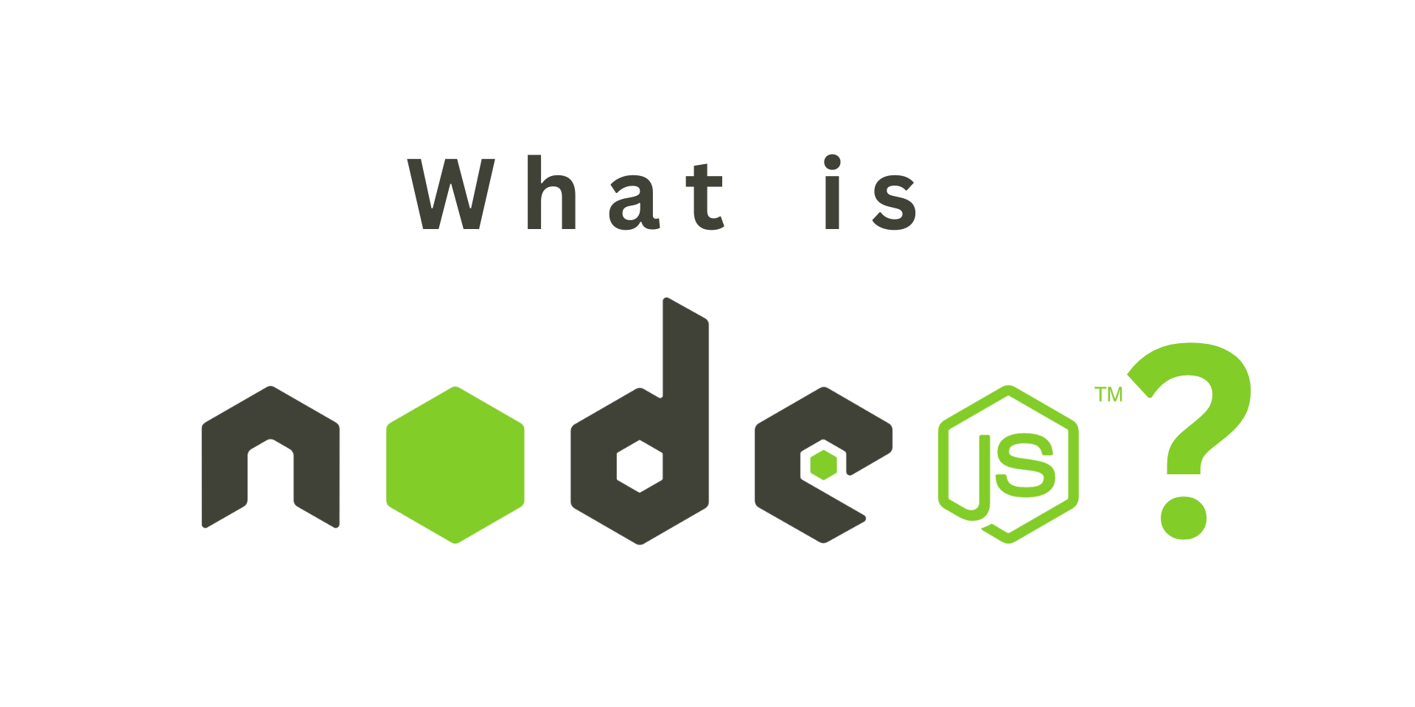
We established at the start of this course that JS is an interpreted language (i.e., not compiled).
JS requires an interpreter, aka a runtime environment, for the computer to execute the code.
This runtime environment can live in the browser, such as how we have been coding with JS so far; or on a dedicated computer, using node.js.
Node.js is a runtime environment for JS, primarily used for coding servers and API interactions.

Slide 6
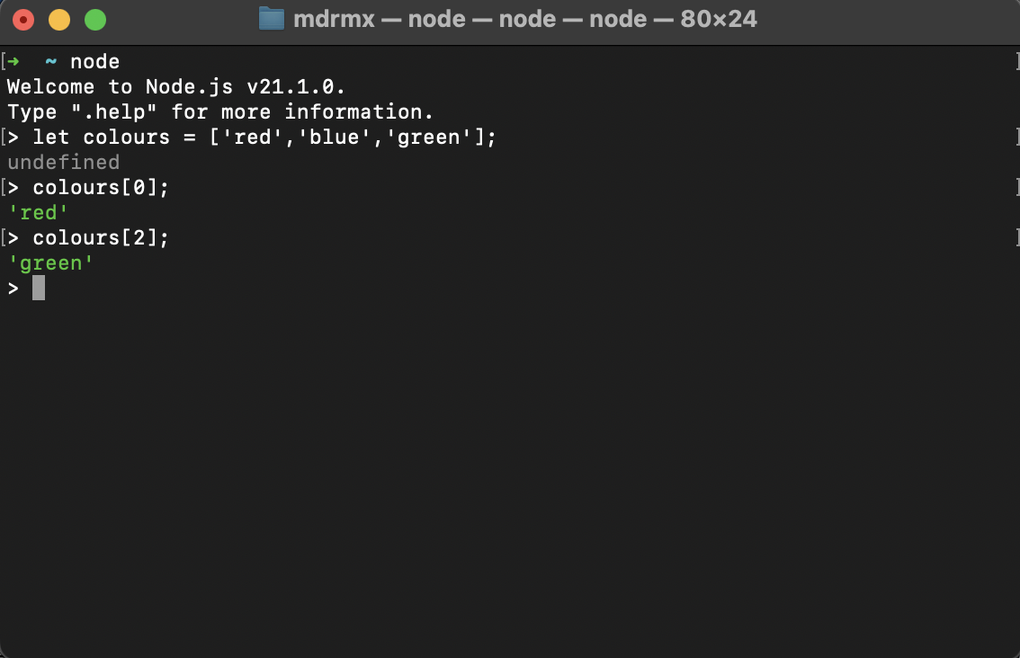
Working with Node
Once Node is installed, you can open your terminal window and type node to start the runtime environment.
You can then start typing JS code into the console.
However, the most common way to use node is to write JS files in a code editor, then run them through node.

Slide 7

Why Node?
We will be using Node to create a server.
A server is an application that runs code and listens for requests from users who want to connect to it.
The server is the central repository for the data of our applications. Users make requests to the server to access this data.
The server then executes the necessary code for the application to function and load the data to the client’s side.

Slide 8

Node Frameworks
A typical way to use node is to use a package or framework which already has some of the functionality you wish your server to have.
Web frameworks provide a standard way to build and deploy web applications and they aim to automate the overhead associated with common activities performed in web dev.
Web frameworks provide libraries for database access, templating frameworks, and session management, and they often promote code reuse.

Slide 9
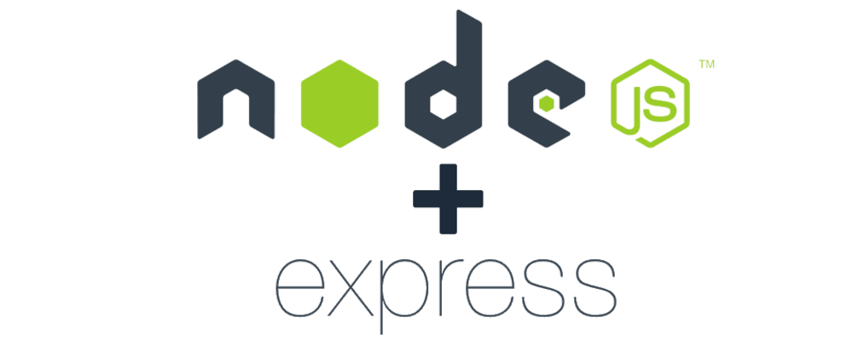
Express.js
We will be using Express.js, which is a minimal and user-friendly framework for creating basic back-end applications.
There are 2 things we need to install Express.js
Create a package.json configuration file using Node Package Manager (npm).
Install express.js with npm.

Slide 10
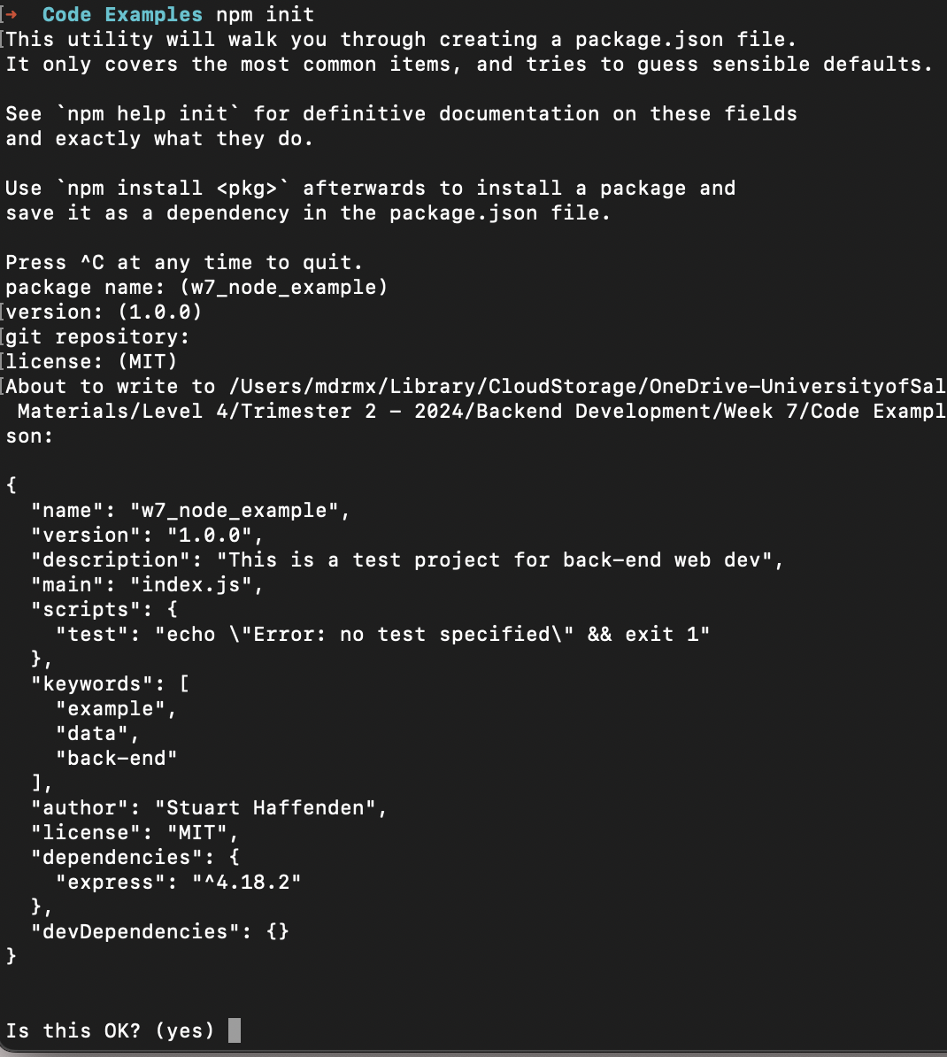
package.json
The package.json file is a configuration file, where all the metadata of our project is set up.
This includes: the packages we are using, the project name, description, authors and copyright licensing.
The npm lets us easily create a package.json file using the npm init command.

Slide 11
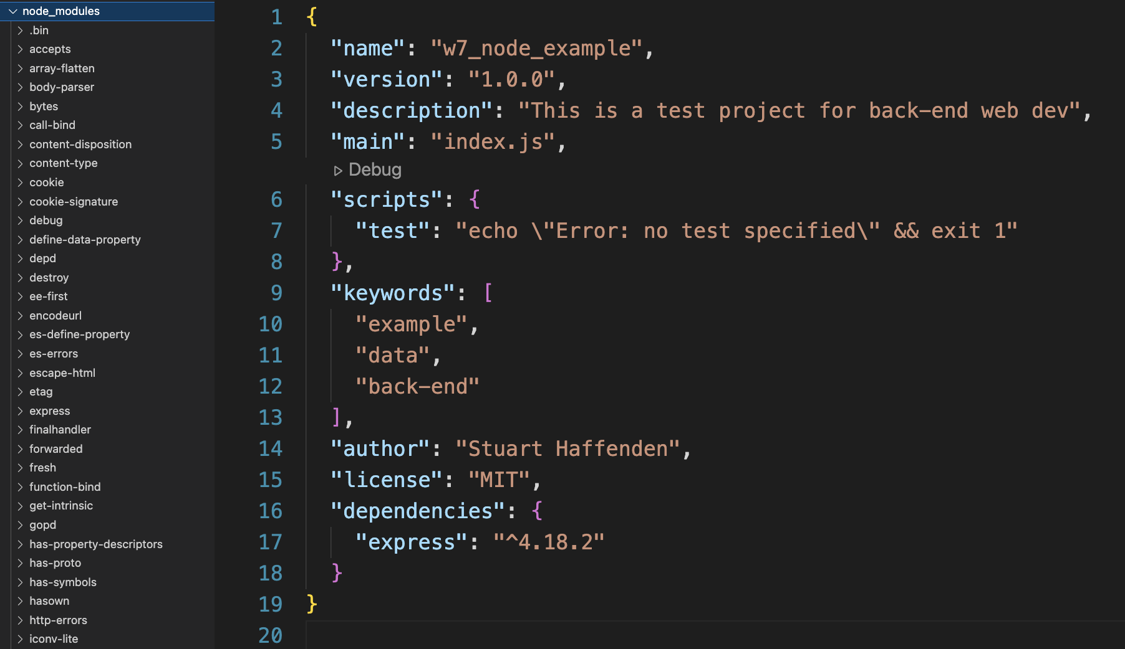
Installing Express
Now that we have a package.json file, we can install Express.js
In the terminal type: npm install express
This will add a folder called node_moduels which contains all the frameworks that express is dependent on.
It will also add express as a dependency inside the package.json file.

Slide 12
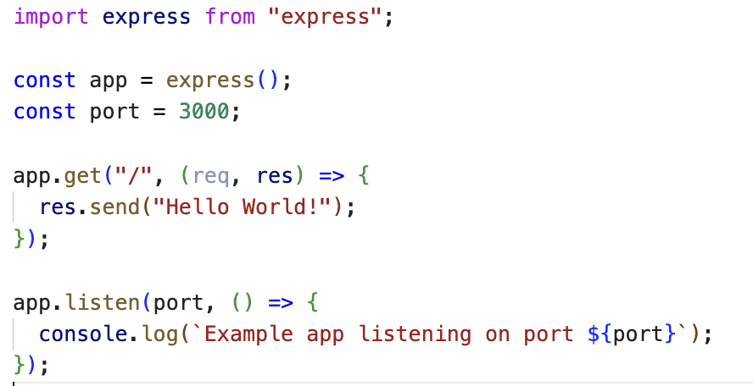
Index.js
Index.js is the default file for writing our server code.
To have access to the express node package we need to use the import statement. This is the ES6 way of importing a package.
Now to create our server web application we use the express() function. This takes the whole express framework and puts it inside a variable.

Slide 13
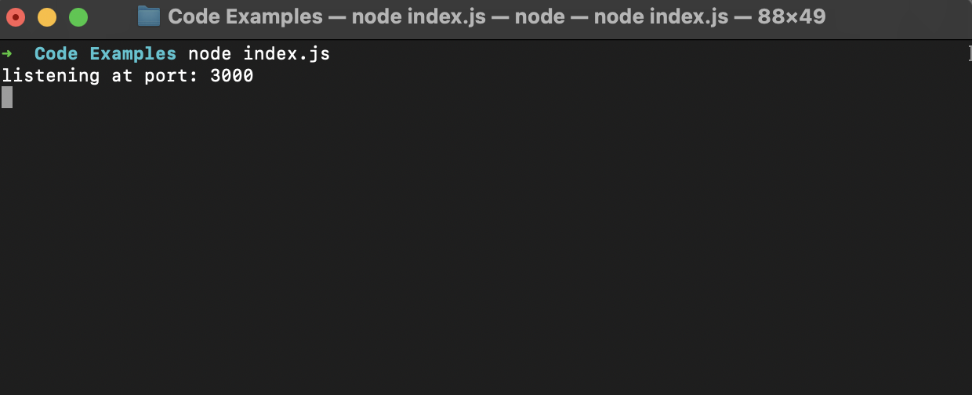
Listening
To make our server listen out for requests we call the listen() function on the variable holding express.js
We can pass it a callback function to log to the console that we are actively listening.
Now that the server is listening, we can visit the server by typing http://localhost:3000/ into our browser.

Slide 14

Serving
Now that we can visit our server, we need our server to do something! Our aim is for our server to:
Serve (host) a web page.
Receive information and save it to a database.
Retrieve information from a database and send it back out.
Handle authentication for API requests.

Slide 15
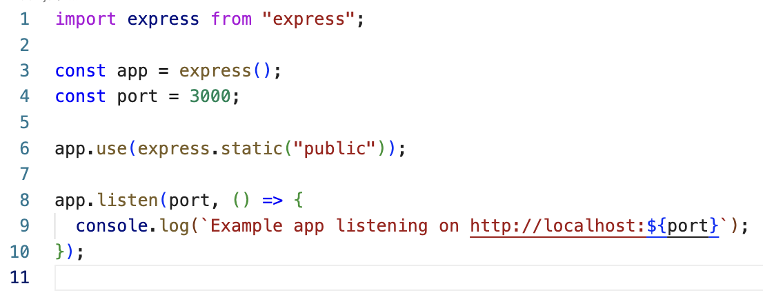
Serving a Web Page
To serve a web page from our server we need to provide an index.html file, such as the one we wrote last week.
We can provide an html file by using two functions:
First we call .use() on our app variable and pass express.static() to the use() function
express.static() passes static files to our application. Static files are files that clients download as they are from the server.
To pass a collection of files to the client side, we can create a ‘public’ folder which contains our static files, such as index.html and any data associated with it.

Slide 16
Client-side and server-side files
It is important to be aware of the distinction of what is being executed client-side vs. server-side.
In our file structure, we have both an index.html and index.js file.
Index.html is what gets executed client-side, whilst index.js will house all our server-side code.
Index.js will serve our website to our client, this means that index.html gets sent to the client’s browser and executed there.

Slide 17
What our server will do
So far we have been creating applications that run client-side only. There are a couple of issues with this.
We have identified some tasks that can’t be done client-side, such as storing and retrieving data.
However, authentication is also something we normally want to do server-side.
For example, if we are requesting data from an API which requires a key, then we don’t want to authenticate client-side since anyone could inspect the html code and get access to your private key.

Slide 18

User-Geolocation
Before we move on to developing our server, let’s get some data from the client-side to send to our server.
If we want to get our user’s geolocation to use in our web app, as in the case of some application like google maps, this can only be done client-side.
One tool we can use for this is the Navigator API. The Navigator API allows us to poll our user’s ‘state’ and identity.
https://developer.mozilla.org/en-US/docs/Web/API/Navigator

Slide 19

The navigator object
The navigator API returns a ‘navigator’ object, which contains many methods for polling our client’s state.
One tool available to us through the navigator object is the Geolocation API
The Geolocation API is accessed via a call to navigator.geolocation; this will cause the user's browser to ask them for permission to access their location data. If they accept, then the browser will use the best available functionality on the device to access this information (for example, GPS).

Slide 20
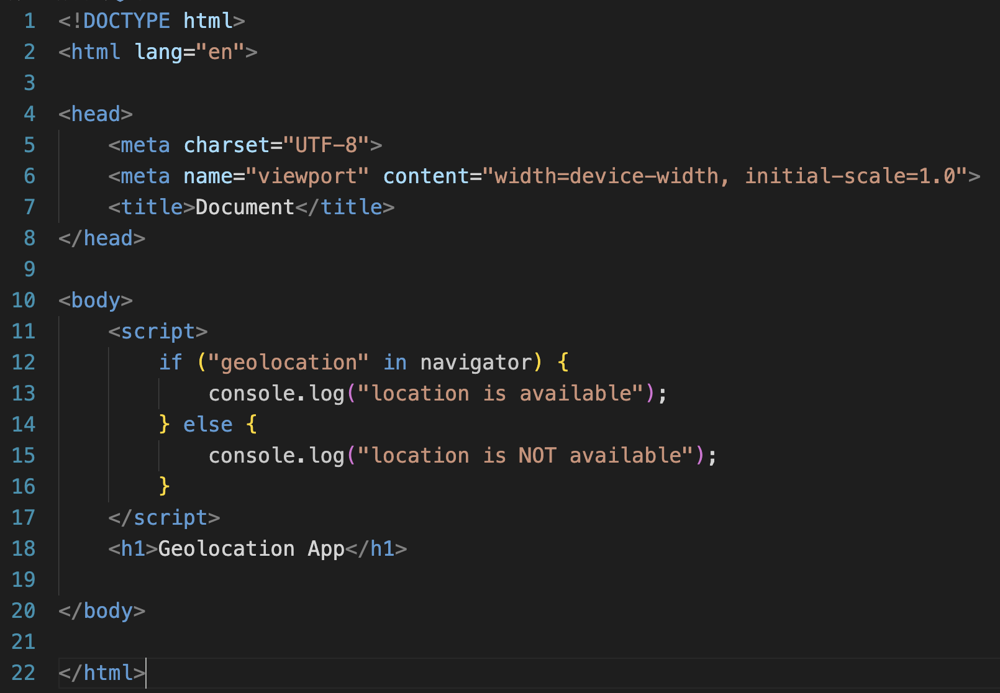
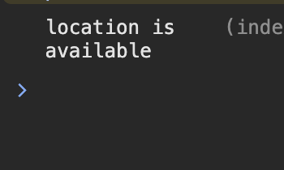
Geolocation
If we visit the documentation, we can find some starter code to put into index.html: https://developer.mozilla.org/en-US/docs/Web/API/Geolocation_API/Using_the_Geolocation_API
Here we can run a quick test to see if the client’s geolocation is or isn’t available to use.

Slide 21
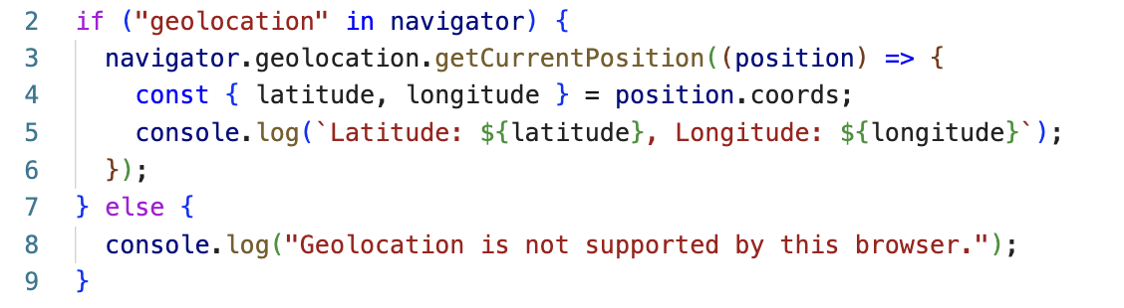
Getting User Location
We can call the getCurrentPosition() function on the navigator object, this returns user's geolocation.
getCurrentPosition() requires a function callback passed as an argument. We can do this by passing an anonymous function, which returns the user’s geolocation as an object.
Once the client accesses this site, they will get a prompt requesting their permission to share their location.

Slide 22
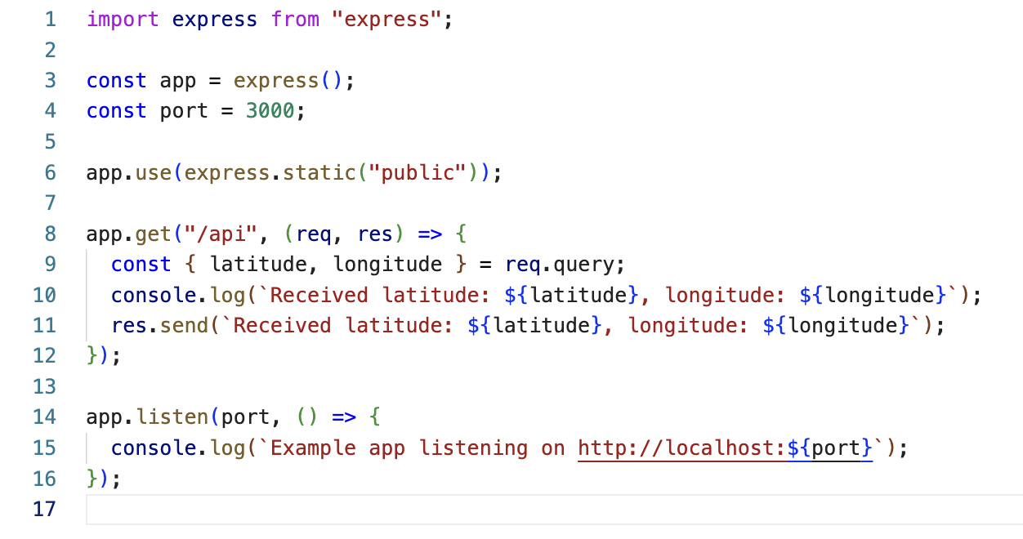
Creating our own API
In order to communicate with our express server we need to create an API endpoint. We can do this using the get() route in express.
Get() takes two arguments:
a string that defines the API endpoint
An anonymous function with two parameters: req and res
The req parameter listens out for data added as a query to the fetch request we create.
We can then use the res variable to send a response back from the server which contains some data.

Slide 23
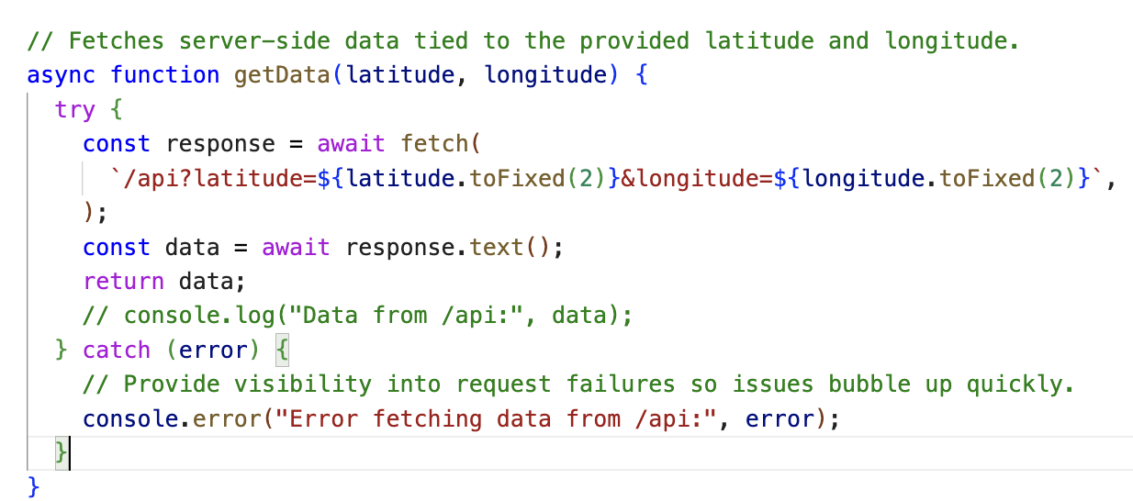
Client-side API get request
Now that we have a get route in our server, we need to make a fetch request from the client side.
We can write an async function to which we will pass our geolocation data.
Our function will then make a get request to the API endpoint we just created and using the query operator (?) encode the data we want to send to our server.

Slide 24
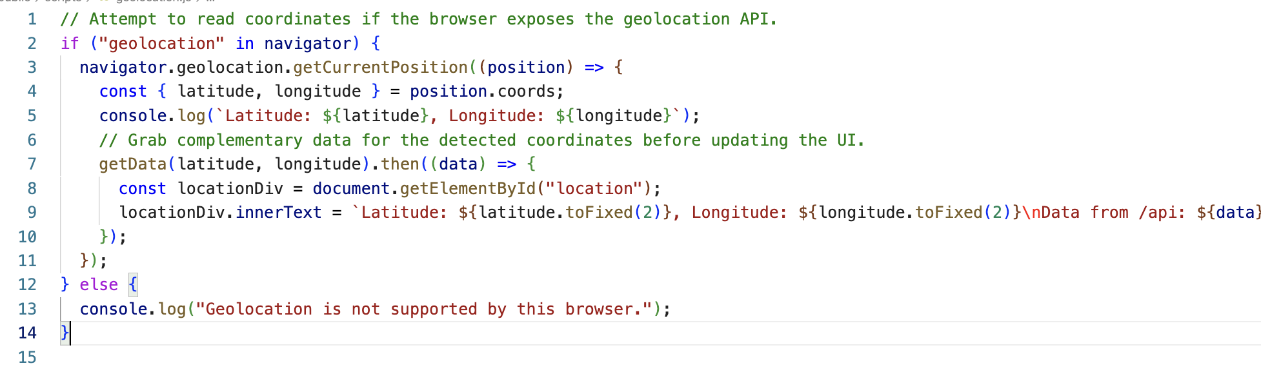
Client-side API get request
Now when we call our getData() function in our main JS code, our function will return the server data. Once the data successfully returns we can insert it into our html page.

